Slide 1
Symphony of the Scriptures
Leviticus
Notes:
Key passages:
“For the life of the flesh is in the blood, and I have given it for you on the altar to make atonement for your souls, for it is the blood that makes atonement by the life” (17:11).
God chose to use a blood sacrifice as part of the sacrificial system of the Jewish people and each time blood was shed, it reminded the people of life and death.
For the Jews, the blood sacrifice reminded them of life and death, specifically, the Passover Feast.
A blood sacrifice also included a cost to the one giving the sacrifice. The price of the animal involved represented a price that had to be paid by the one providing the offering. Each time a blood sacrifice was made, the one giving it was reminded of the cost of sin.
- “Speak to all the congregation of the people of Israel and say to them, You shall be holy, for I the Lord your God am holy” (11:44).
- “Consecrate yourselves, therefore, and be holy, for I am the Lord your God. ⁸ Keep my statutes and do them; I am the Lord who sanctifies you” (19:2)
- “But as he who called you is holy, you also be holy in all your conduct, ¹⁶ since it is written, “You shall be holy, for I am holy” (1 Pe. 1:15-16)
“Consecrate yourselves, therefore, and be holy, for I am the Lord your God. ⁸ Keep my statutes and do them; I am the Lord who sanctifies you.
Notes:
How does the book of law apply to Christians today? We no longer are obligated to offer animal sacrifices; neither are our schedules stuffed with a regimen of ceremonial cleansing. Aren’t we fortunate? That said, how do we handle the sin problem?
The book of Hebrews is the key to unlocking the spiritual significance of Leviticus - for one must know the Book of Leviticus to understand epistle of Hebrews. With that understanding it is not at all difficult to see how the word “better” is the keyword in Hebrews (reading 9:13-10:18 is helpful - see the emphasis of the blood).
“…without shedding of blood is no remission” (9;22)
“For it is impossible for the blood of bulls and goats to take away sins” (Heb. 10:4)
The Hebrew writer calls the Leviticus material symbols (Heb. 9:9) - “gifts and sacrifices are offered that cannot perfect the conscience of the worshipper.” Only Christ could solve the sin problem.
He said they are copies of heavenly realties (Heb. 9:23) - “Thus it was necessary for the copies of the heavenly things to be purified with these rites, but the heavenly things themselves with better sacrifices than these.”
He refers to those things in Leviticus as “a shadow of good things to come…it can never, by the same sacrifices that are continually offered every year, make perfect those who draw near.” (Heb. 10:1).
So when we read Leviticus, we should rejoice. Not only because we are not under bondage to all the ceremonial and ritual observances, but because we are under a better system - one that provides access to God through Christ’s sacrifice made “once for all” (Heb. 10:10).
Only through Him, can we be found holy, fulfilling God’s command to be “holy as He is holy” (Lev. 19:2).

Slide 2
Leviticus
Circa
1446 B.C.
The Way to God
Access
The Walk with God
Lifestyle
“You shall be holy, for I the Lord
your God am holy (19:2; 20:7-8; 11:44)
The approach: Offerings
Practical Guidelines
The representative: Priest
Chronological observances
The laws: Cleansing
Physically
Spiritually
Severe Consequences
Verbal Promises
Chapters 1-17
Chapters 18-27
Emphasis
Ritual (for worship)
Practical (for living)
Location
Mount Sinai…one full year
Key Questions
How can sinful humanity worship a holy God?
Key Verses
11:44; 17:11; 19:2; 20:7-8
Key Term
Holy (occurs 9o times)
Christ in
Leviticus
Pictured in each sacrifice and ritual (17:11)
Notes:
Leviticus (about Levites) tells us of the special requirements of the priestly tribe to work as agents for the people as they worshipped God. Remember that the Israelites were God’s own people (Ex. 19:5-6). The title is fitting because it is an instruction manual for the Israelites to know how to enter the presence of God for worship. The book outlines the sacrificial and ceremonial details, describes how the people were to be a holy nation, how they were to treat one another, and how they were to reflect God in their own lives. After arriving at Mt. Horeb (Sinai) the Israelites spent about a year at the foot of the mountain after Moses had received the law where the tabernacle was built and the people learned that God wanted more than compulsory worship, He wanted a relationship with them. Leviticus is divided into two major sections: The way to God (Chapters 1-17) and the walk with God (Chapter 18-27). In section one God provides for the sins of the people to be atoned by the “blood” sacrifices (17:11; cf. Heb. 9:22), to receive forgiveness or cleansing they had to come to God on His terms. Section one has five divisions: Burnt offering (1:6-8:13); Grain offering (Chapter 2; 6:14-23); Peace offering (Chapter 3; 7-11:36); Sin offering (Chapter 4:1-5:13; 6:24-30); Guilt offering (5:14-6:7; 7:1-10). In Chapters 8-10 the priestly requirements are outlined, including their clothing, animal types, how to offer them, where to stand, what to drink, and what to eat. Two of the priests, Nadab and Abihu offer up “false fire” and lose their lives because of their frivolous approach to these requirements (Chapter 10). The completion of the first section reflects the laws of purity (Chapters 11-17) emphasizing the contrast of clean (pure) versus unclean (impure) in what was offered (swine, cud hewers, etc.) and how they would be perceived themselves (circumcision, leprosy, etc.).
Section two implies “holy living” (Chapter 18-22, especially, 18:3-5) and “holy times” (Chapters 23-25) that included the feasts or festivals: Passover, Unleavened Bread, First Fruits, Pentecost, Trumpets, Day of Atonement and Tabernacle (Booths) - all vital to their relationship with God (Chapter 26, especially verse 46).
Application:
Jesus is our offering and does for the Christian what bulls and goats did for the Israelites (Heb. 9:9, 12-14; 10:1-4).
Because of Jesus we can rejoice that we are no longer under the Law and are free from the cumbersome observance of ceremonial rituals.
As priests (1 Pe. 2:9) we are to be holy in our living. We are the “holy priesthood” and we must not give God less that the “sweet smelling savor” He demands (Eph. 5:2).
Key thought: Is it possible that we are guilty of giving God less than our best? Is He happy when we offer up “false fire” in our worship? Can we nit see in Leviticus that God’s holiness matters and that God will hold us accountable for our actions?

Slide 3
Period | History Covered | Scriptures | Years | Principal
Antediluvian | Creation to the Flood | Gen. 1-7 | 1656 | Adam
Postdiluvian | From the flood to call of Abraham | Gen. 8-!1 | 427 | Noah
Patriarchal | From the call of Abraham to Egyptian Bondage | Gen. 12-45 | 215 | Abraham
Egyptian Bondage | From Egyptian Bondage to the Exodus | Gen. 46-Ex. 11 | 215 | Joseph
Wilderness Wanderings | From Exodus to crossing of the Jordan | Ex. 12-Deut. 34 | 40 | Moses
Conquest of Canaan | From crossing of Jordan to Joshua’s death | Josh. 1-24 | 51 | Joshua
Judges | From Joshua to King Saul | Ju, Ruth, 1 Sa. 1-9 | 305 | Samuel
The United Kingdom | From origin of kingdom to its division | 1 Sa. 9-1 Ki. 11; 1 Chr. 10, 2 Chr. 9 | 120 | David
The Divided Kingdom | From the division to the fall of Israel | 1 Ki. 12-2 Ki. 20; 2 Chr. 10-32 | 253 | Elijah
Judah Alone | From fall of Israel to the fall of Judah | 2 Ki. 21-25; 2 Chr. 10-32 | 125 | Josiah
Babylonian Captivity | From the fall of Judah to the return | 2 Ki. 25-8- 21; Dan. 1-6 | 70 | Daniel
Restoration of the Jews | From the return to end of OT history | Ezra, Nehemiah | 92 | Ezra
Between the Testaments | From end of OT to the beginning of the NT | None | 400 | Judas Maccabee
Life of Christ | From birth of Jesus to ascension | Mt-Jhn 21; Acts1 | 34 | Jesus
The Church | From ascension to death of Paul (96 AD approx.) | Acts 2-Revelation | 70 | Paul

Slide 4
The Pentateuch
Book of the Pentateuch | What it tells us about humanity | What it tells us about God
Genesis | Ruin and rebellion through sin | Sovereignty
Exodus | Redemption from bondage | Omnipotence
Leviticus | Communion and fellowship | Holiness
Numbers | Redirection | Justice
Deuteronomy | Instruction | Faithfulness
Notes:
The first five books of the Bible make up the Pentateuch (from penta, the Greek word for five, and teuchos, which means tool). Otherwise known as the Torah - Each the five books written by Moses.

Slide 5
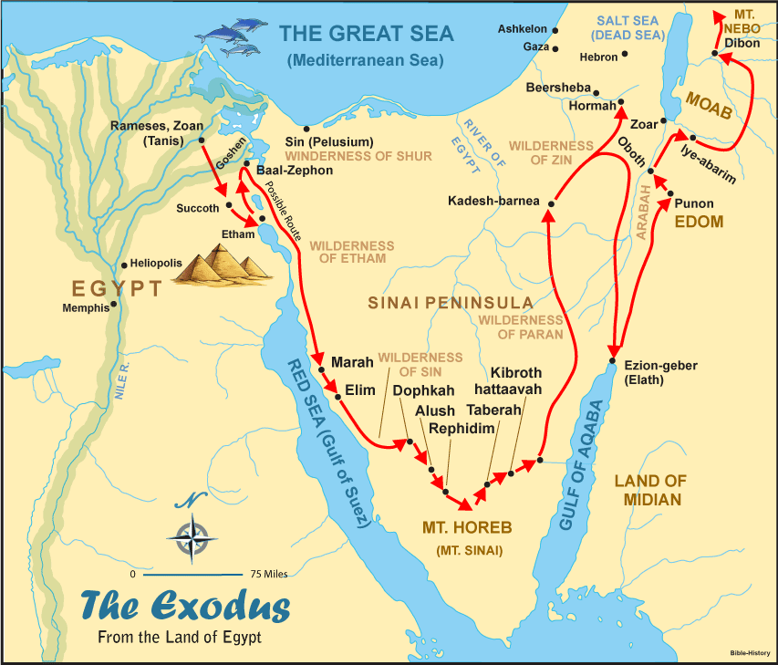

Slide 6
Introduction to the The Laws of Moses
“Most of the laws (Moses) are set forth in the forms of statutes. Others are in the nature of case decisions or ethical duties. Some of the laws are given to meet only temporary or immediate needs, while others are intended to last for centuries. The laws are to be read to the people at regular times throughout each year in order that each person can learn them and have no excuse for not obeying them.
Th3 explicit purpose for each law is rarely given. However, most of the laws are ultimately designed to teach the Israelites to respect and honor God, to make them holy and aware of the separateness as a specially chosen people, and to learn respect for the rights of their neighbors. Laws regulating personal injury, or even diet, are no less significant than those regulating offerings and sacrifices, for all laws are essentially religious laws. All are given by a personal God and Lawgiver to whom the people have sworn allegiance and promised obedience.

Slide 7
The laws of Israel may sometimes appear to be cruel or unnecessarily harsh, particularly the penalties which accompany given offenses. Yet what may appear to be cruel and unusual in modern times must be viewed in the context of life and times in which the Israelites are living. Death and suffering are very much a reality to all people of this time, and in the surrounding nations wicked kings practice unspeakable cruelties in ruling their people. Thus the laws given to Moses are designed to lift the national consciousness and impose a high level of ethical conduct. Even the death penalty is an elevating concept in teaching the value of human life, and the procedural safeguards which are imposed insure a measure of unparalleled fairness. In fact, the concepts of due process and equal justice found within this legal system will be incorporated even centuries later into enlightened systems of modern law.” --- F. LaGard Smith, The Narrative Bible, page 220.

Slide 8
Who wrote the book?
The content of Leviticus relates directly to Exodus, providing evidence that the same hand penned both books. The arguments that support Moses’s writing of Exodus also uphold Moses’s authorship of Leviticus. Additionally, we find more than fifty occasions when the text says something like, “The LORD spoke to Moses” (Leviticus 1:1; 4:1; 5:14; 6:1). The New Testament also refers to Moses as the author of passages from Leviticus (Matthew 8:4; Luke 2:22; Hebrews 8:5).
The word Leviticus derives from the tribe of Levi, whose members were set aside by the Lord to be His priests and worship leaders. As a title, the word is translated from the Septuagint, meaning “ ‘pertaining to the Levites,’ and although that tribe as such is not emphasized throughout the book, the priestly subject matter renders the title appropriate its content was originally meant to instruct the new nation of Israel in proper worship and right living, so that they might reflect the character of their divine King.

Slide 9
Where are we?
The Law found in Leviticus was spoken by God to Moses at or near Mount Sinai, where the Israelites camped for some time. Because God delivered these detailed laws after the original Ten Commandments, the most probable date for their revelation is 1446 BC. Whether every law was written down at that time is impossible to determine; it may be that they were codified progressively during the ensuing forty-year wandering.

Slide 10
Why is Leviticus so important?
The book of Leviticus was the first book studied by a Jewish child; yet is often among the last books of the Bible to be studied by a Christian.. Today’s readers are often put off by the book’s lists of laws regarding diet, sacrifice, and social behavior. But within these highly detailed directives we discover the holiness—the separateness, distinction, and utter otherness of God. And we learn how sin devastates humanity’s relationship with their Creator. God established the sacrificial system so that His covenant people might enjoy His fellowship through worship; it also allowed for repentance and renewal:
“When an Israelite worshiper laid his hand on the animal victim, he identified himself with the animal as his substitute . . . this accomplished a symbolic transfer of his sin and a legal transfer of his guilt to the animal victim. God then accepted the slaughter of the animal . . . as a ransom payment for the particular sin which occasioned it.” --- F. Duane Lindsey, "Leviticus," in The Bible Knowledge Commentary: Old Testament
Many years after Moses wrote Leviticus, Jesus came to offer Himself as the ultimate sacrifice, holy and perfect, once for all, fulfilling the Law and rendering future animal sacrifices unnecessary and void (Hebrews 10:10)..

Slide 11
What's the point?
The overall message of Leviticus is sanctification. The book communicates that receiving God’s forgiveness and acceptance should be followed by holy living and spiritual growth. Now that Israel had been redeemed by God, they were to be purified into a people worthy of their God. “You shall be holy, for I the Lord your God am holy,” says Leviticus 19:2. In Leviticus we learn that God loves to be approached, but we must do so on His terms.

Slide 12
How do I apply this?
This theme of holiness extends to the church. In the New Testament,
1 Peter 1:15–16 references Leviticus 19:2 when it says: “but as he who called you is holy, you also be holy in all your conduct, 16 since it is written, “You shall be holy, for I am holy.’” Those who are redeemed by the mercies of God offer different sacrifices today; they offer themselves (Romans 12:1).
Like He did with the Israelites, God has redeemed and consecrated Christians. Jesus offered Himself as the perfect sacrifice on our behalf, taking the punishment that we deserved so that we might be forgiven. He is the sacrificial Lamb! Those who place their trust in Jesus’s atoning act become God’s children, saved by grace (Ephesians 2:8–9).
If you are His child, then He wants you to reflect His character. He is sanctifying you much like He did the nation of Israel. Does your life echo His? Are you obedient?

Slide 13
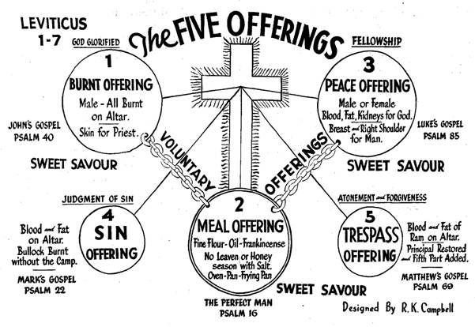

Slide 14
Five Offerings - Chapters 1-5
Burnt Offering (Leviticus 1)
Only offering to be totally consumed on the altar with nothing eaten by men
First offering mentioned by name in the Bible (Genesis 8:20)
Most common of the offerings mentioned in scripture (197 times)
Voluntary offering and a sweet savor to the Lord
Indicates entire surrender
Meal Offering (Leviticus 2)
Only offering made without the shedding of blood and without an animal sacrifice
Offering of fine flour; no animal flesh
Voluntary offering and a sweet savor to the Lord
Indicates a living sacrifice

Slide 15
Peace Offering (Leviticus 3)
Only offering in which the offeror could eat of the meat of the sacrifice
Voluntary offering and a sweet savor to the Lord
Indicates fellowship or communion
Sin Offering (Leviticus 4)
Required offering; not a sweet savor
Dealt with the sinner and the problem of sin
Indicates payment for sin
Trespass Offering (Leviticus 5)
Required offering; not a sweet savor
Dealt with particular sins
Indicates forgiveness of committed sins

Slide 16
Five Types of offerings & Jesus Christ
Levitical Offering
Picture of Christ
Burnt offering (ch. 1; 6:8-13)
Grain Offering (ch. 2; 6:14-23)
Peace offering (ch. 3; 7:11-16)
Sin offering (4:1-5:13; 6:24-30)
Guilt (trespass)Offering (5:14-6:7; 7:1-10)
His total consecration (Phil. 2:6-8)
His sinless service (Jn. 4:34)
His crucifixion (Eph. 2:13-14)
His bearing of our sins (Heb. 9:26)
His payment for the damage of sin (Heb. 10:12)
Burnt Offering 197 times
Meat Offering 123 times
Sin Offering 119 times
Peace Offering 43 times
Trespass Offering 36 times

Slide 17
The Seven Feasts (Leviticus 23)
Passover - 23:4-5
Unleavened Bread - 23:6-8
First fruits - 23:9-14
Weeks - 23; 15-21
Trumpets - 23:23-35
Day of Atonement - 23:26-32
Tabernacles (Booths) - 23:34-36

